Slide 1
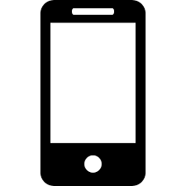
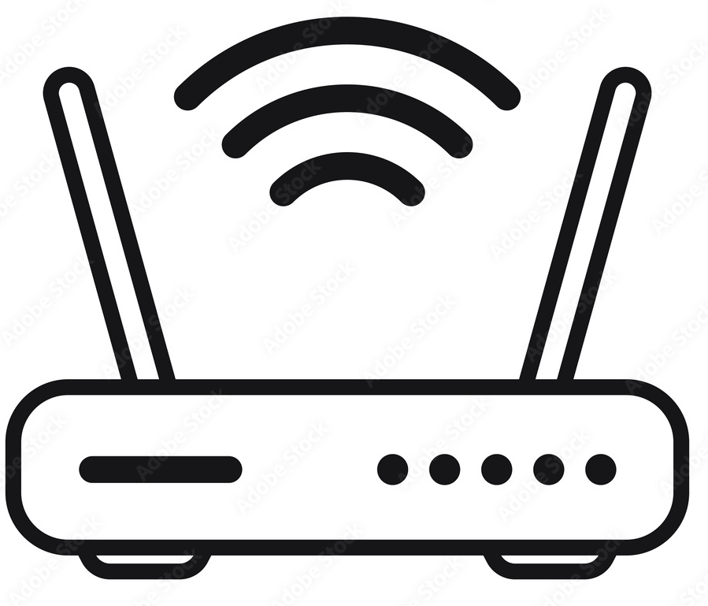


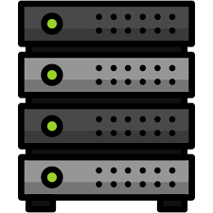
Router remembers every
Device’s IP and requests
Device IP address with request(1.1.1.1)
1.1.1.1
ISP remembers every
Users’ IP and requests
Router IP, Shared IP with requests(3.1.1/9.1.0.2)
3.1.1
Device IP address with request(2.2.1.1)
2.2.1.1
All request with shared IP address(9.1.0.2)
Device IP address with request(4.1.1.2)
ISP
Server
4.1.1.2
Router IP, Shared IP with requests(8.1.1/9.1.0.2)
Device IP address with request(5.1.1.2)
8.1.1
5.1.1.2

